Slide 1
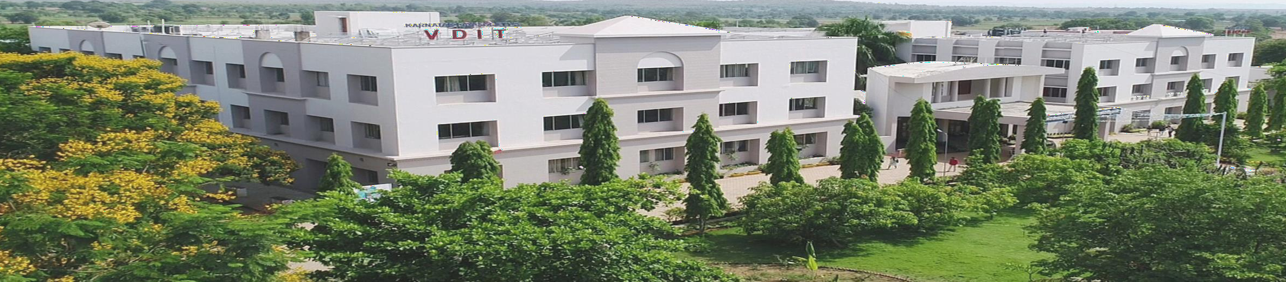







Karnataka Law Society's
INSTITUTE OF TECHNOLOGY (VDIT)
Transforming Through Technology
Department of
Electronics and Communication Engineering
w w w . k l s v d i t . e d u . i n
1939
2004
2023

Slide 2



A Presentation entitled
Body Posture Monitor For Desk Workers
Visvesvaraya Technological University, Jnana Sangama, Belagavi – 590 018
KLS Vishwanathrao Deshpande Institute of Technology,
Haliyal – 581 329
(Accredited by NAAC with “A” Grade)
Presented by
Under the Guidance of
Dr. Nagaraj. Bhat
Department of E&CE
(Academic Year 2024-25)
Srushti Kolekar | 2VD23EC106
Sudeep T. Gotur | 2VD23EC107
Suhas Rotti | 2VD23EC108
Sujata S. Waghamode | 2VD23EC110

Slide 3
PRESENTATION OUTLINE
Motivation
Introduction
Literature Survey
Objectives
Block Diagram
Circuit Diagram
Working
Outcomes
Advantages
Applications
References
Acknowledgement

Slide 4
MOTIVATION
Many desk workers suffer from back pain and neck pain
People unknowingly sit in the wrong posture for long hours
No real-time alert system to correct posture
Medical treatment is costly and time-consuming
Prevention is better than a cure
Simple technology can improve daily life
Our goal is to use sensors to improve human health
This project brings technology and health together

Slide 5
INTRODUCTION
Body posture is the position in which we sit or stand
Correct posture keeps the spine healthy
Desk workers sit for long hours daily
Wrong sitting posture causes: ( Back pain, Neck pain, Shoulder strain)
Most people do not realise when their posture is wrong
Technology can help by detecting posture automatically
Our project monitors posture and gives feedback using vibration alerts

Slide 6
LITERATURE SURVEY
SL.NO | Paper Title | Author Names | Proposed Work | Published Year
1 | UWB-PostureGuard: A Privacy-Preserving RF Sensing System for Continuous Ergonomic Sitting Posture Monitoring | Haotang Li, Zhenyu Qi, Sen He, Kebin Peng, Sheng Tan, Yili Ren, Tomas Cerny, Jiyue Zhao, Zi Wang | Proposes a contactless, UWB (ultra-wideband) RF sensing system that continuously monitors sitting posture with 99.11% accuracy. It preserves user privacy (no camera/wearables) and is robust to variations like clothing, furniture, and environment. | 2025
2 | Sitting Posture Recognition and Feedback: A Literature Review | Christian Krauter, Katrin Angerbauer, Aimée Sousa Calepso, Alexander Achberger, Sven Mayer, Michael Sedlmair | Comprehensive literature review (N=223) across engineering, electronics, medical sciences; highlights use of pressure-sensing hardware and visual feedback; discusses factors such as environment, cost, privacy, portability, accuracy, user capability and long-term effects | 2024
3 | Sensor-Based Wearable Systems for Monitoring Human Motion and Posture: A Review | Xinxin Huang, Yunan Xue, Shuyun Ren, Fei Wang | Systematic review of wearable posture-monitoring systems; analyses sensor types (IMU, flex, pressure), placement strategies, system design aspects, and emphasises future needs like accuracy, data security, comfort, and durability. | 2024

Slide 7
LITERATURE SURVEY
SL.NO | PAPER TITLE | AUTHOR NAMES | PROPOSED WORK | PUBLISHED YEAR
4. | A Smart System for Sitting Posture Detection Based on Force Sensors and Mobile Application | Slavomir Matuska, Martin Paralic, Robert Hudec | Presents a smart chair with six flexible force sensors connected to an Arduino-based IoT node; detects incorrect sitting positions and sends feedback to a mobile app, with posture data stored in a private cloud and visualized via mobile UI. | 2022
5. | Human Posture Detection Method Based on Wearable Devices | Xiaoou Li Yangang Li Yuanming Wu Jiahui Xu Zhitao Xiao | Proposes a multimodal wearable posture detection method using upper-limb sEMG, lower-limb inertial and plantar pressure sensors; features are extracted via wavelet transforms and classified using optimized SVM with ~90% accuracy. | 2021

Slide 8
OBJECTIVES
To design a posture monitoring system for desk workers.
To measure body angle using the MPU6050 sensor.
To process sensor data using ESP32.
To detect wrong posture accurately.
To alert the user using vibration feedback.
To avoid false alerts during temporary movements.
To implement a 40-second delay before triggering vibration.
To improve health and working comfort.

Slide 9
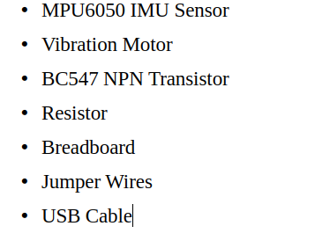
COMPONENTS

Slide 10
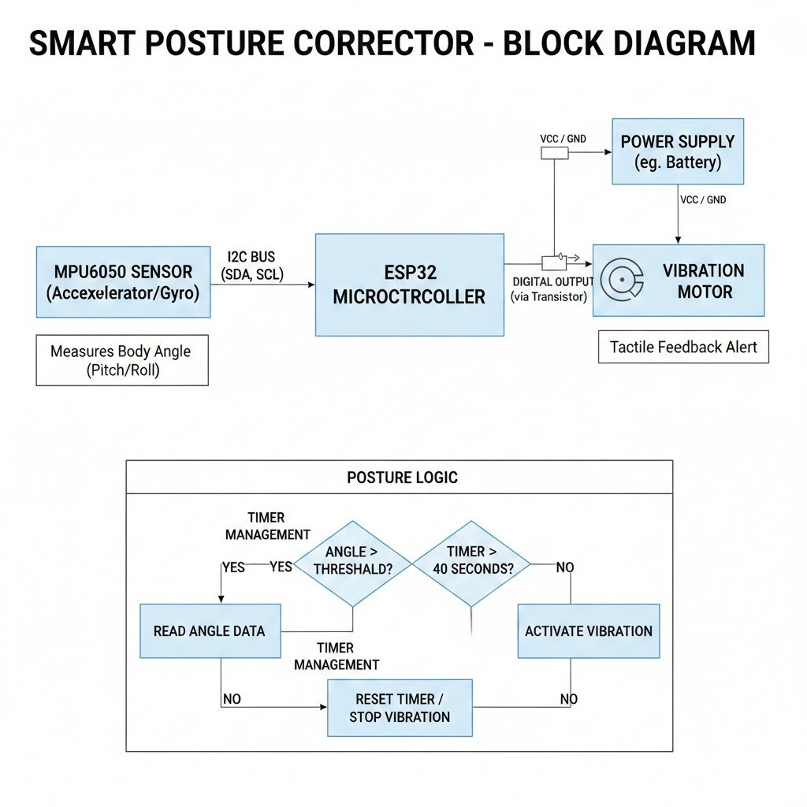
BLOCK DIAGRAM
YES
NO

Slide 11
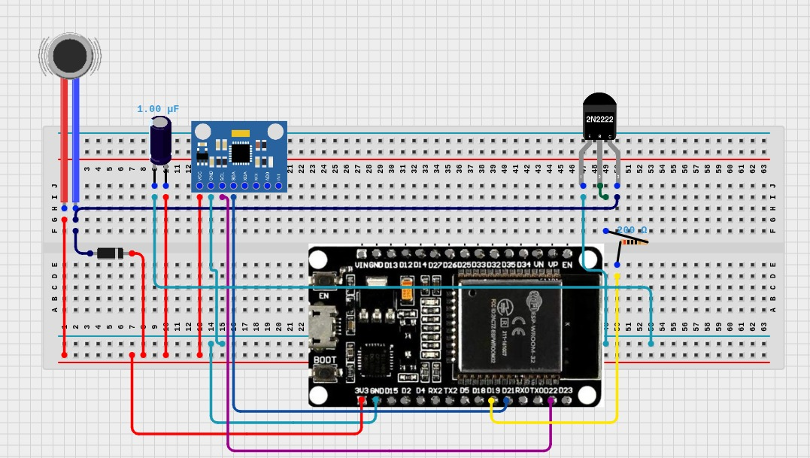
CIRCUIT DIAGRAM
Fig.1 : Block Diagram of Body Posture Monitor For Desk Workers

Slide 12
WORKING
The MPU6050 sensor continuously measures body angle.
ESP32 reads angle data from MPU6050.
The angle is compared with a preset normal posture value.
If posture is correct → System continues monitoring.
If posture is wrong, → Timer starts counting.
If posture is corrected within 40 seconds, → Timer resets.
If posture remains wrong for more than 40 seconds →
➤ Vibration motor is activated.
Vibration alert reminds user to correct posture.
Once posture is corrected → Vibration stops.

Slide 13
OUTCOMES
The system accurately detects the user's body posture.
It continuously monitors posture in real time.
The vibration alert effectively notifies the user when posture is incorrect.
False alerts are reduced by using a delay timer mechanism.
The system helps increase awareness about correct posture habits.
Users receive a physical reminder through vibration to correct their posture.
The system is portable and suitable for daily use.
The project helps in reducing long-term back and neck problems.

Slide 14
ADVANTAGES
The system helps users maintain correct sitting posture.
It provides real-time feedback through vibration alerts.
The delay timer prevents unnecessary or false alerts.
The device is simple and easy to operate.
The system is affordable and cost-effective.
People of all age groups can use it.
The device improves long-term spinal health.

Slide 15
APPLICATIONS
The system can be used in corporate offices to promote healthy working posture.
It is suitable for educational institutions to improve students’ and teachers sitting habits.
The device is useful in call centers and BPO industries.
It can be implemented in co-working spaces.
It is useful for people with back or neck discomfort.
The system can be used in rehabilitation and physiotherapy centers.
It is suitable for training programs focused on workplace safety.
The device can be used to monitor posture during long reading or writing sessions.

Slide 16
REFERENCES
Haotang Li, Zhenyu Qi, Sen He, Kebin Peng, Sheng Tan, Yili Ren, Tomas Cerny, Jiyue Zhao, Zi Wang, “UWB-PostureGuard: A Privacy-Preserving RF Sensing System for Continuous Ergonomic Sitting Posture Monitoring,” 2025.
Christian Krauter, Katrin Angerbauer, Aimée Sousa Calepso, Alexander Achberger, Sven Mayer, Michael Sedlmair, “ Sitting posture Recognition and Feedback: A Literature Review.”:2024.
Xiaoou Li, Yangang Li, Yuanming Wu, Jiahui Xu, Zhitao Xiao,” Human Posture Detection Method Based on Wearable Devices”:2021
Slavomir Matuska, Martin Paralič, Robert Hudec, “A Smart System for Sitting Posture Detection Based on Force Sensors and Mobile Application”, 2022

Slide 17
ACKNOWLEDGEMENT
We would like to thank our Honourable Principal, Dr V. A. Kulkarni sir for their fabulous support.
We would like to thank Dr Nagaraj Bhat sir, for their fabulous support.
We would like to express our special thanks to our guide, Dr Nagaraj Bhat for their guidance in choosing this project, “Design and Implementation of Body Posture Monitor For Desk Workers”.

Slide 18
THANK YOU

